Slide 1
Predictors of Movie Box Office Success: An Empirical Analysis of Factors Influencing Film Revenue
GROUP: ASSIGNMENT - 4
Team Members:
Uday Bhaskar Valapadasu – 11696364
Rohit Suddala - 11652459
Sapthagiri Naik Bhukya – 11699072

Slide 2
Objective
Examine key factors impacting movie box office success
Create predictive models for estimating box office revenue
Offer practical recommendations for the film industry based on findings

Slide 3
Problem Statement
Identify key predictors of movie box office success
Analyze 12 independent numerical variables
Develop and compare multiple predictive models
Explore changing dynamics of success factors over time

Slide 4
Critics
Assessing social media's impact on box office performance using current data.
Analyzing a comprehensive set of variables for a holistic view of success factors.
Examining how predictors of box office success have changed over time.
Comparing the influence of critical reviews versus audience reception.
Employing machine learning to uncover complex relationships between variables.

Slide 5
goals
Develop a predictive model for box office revenue with R-squared ≥ 0.7.
Identify top 5 influential factors affecting box office success.
Perform statistical analyses including confidence intervals and hypothesis tests.
Complete the project within the course deadline, utilizing existing resources.
Ensure comprehensive analysis of all variables in the Kaggle dataset.

Slide 6
Specifications
Resource Category | Details
Computational Resources | Personal computers with sufficient RAM(8GB) and processing power
Software | Python, Jupyter Notebooks, libraries (pandas, numpy, scikit-learn, matplotlib, seaborn)
Dataset | Kaggle Existing movie dataset with 12 independent numerical variables and 1 dependent variable
OS & Required Resource | Windows/MacOS & 3 laptops/PCs

Slide 7
Implementation plan executed
Conduct EDA and hypothesis testing to inform model building.
Develop and compare multiple predictive models for box office revenue.
Use Python environment with necessary libraries for data analysis and modeling.
Follow a structured process: data preprocessing, EDA, feature engineering, model development, evaluation, and interpretation.
Complete the project within the course deadline using existing resources.

Slide 8
Exploratory Data Analysis
Analyzed distribution of key variables (e.g., gross revenue, budget, IMDB score)
Identified right-skewed distributions for most variables Discovered outliers in several variables
Visualized relationships between variables using scatter plots and heatmaps

Slide 9
Dependent Variable: Gross Revenue
The analysis of gross revenue in the movie dataset reveals a highly skewed distribution. Most films earn relatively low revenues, while a few blockbusters generate exceptionally high earnings. This is evident from the right-skewed histogram, scattered plot with outliers, and non-linear Q-Q plot. The box plot further emphasizes the presence of high-revenue outliers. With a mean of about $51 million and a standard deviation of nearly $70 million, the data shows high variability. All records have valid gross revenue values. This distribution highlights the significant disparity in movie earnings within the industry.

Slide 10
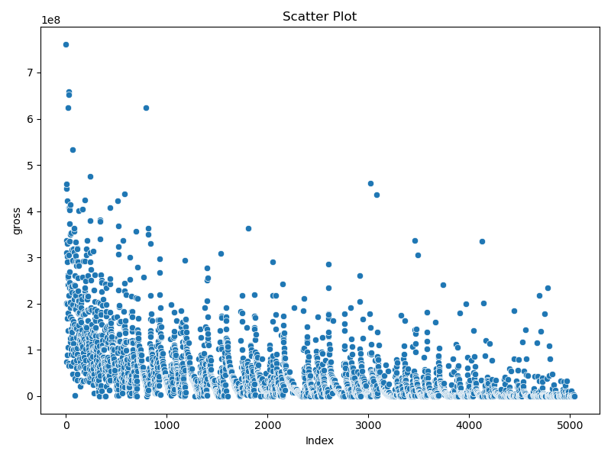
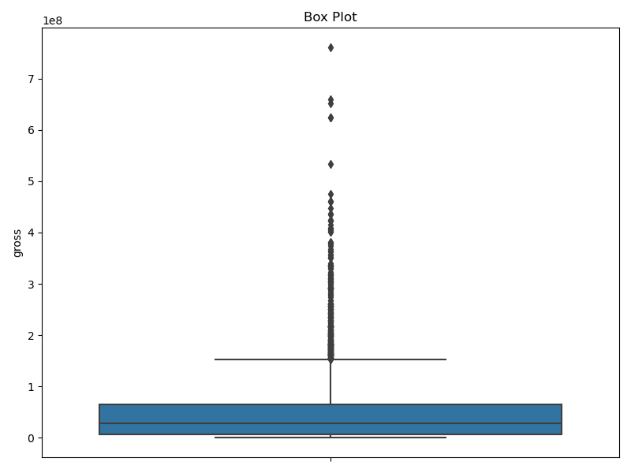
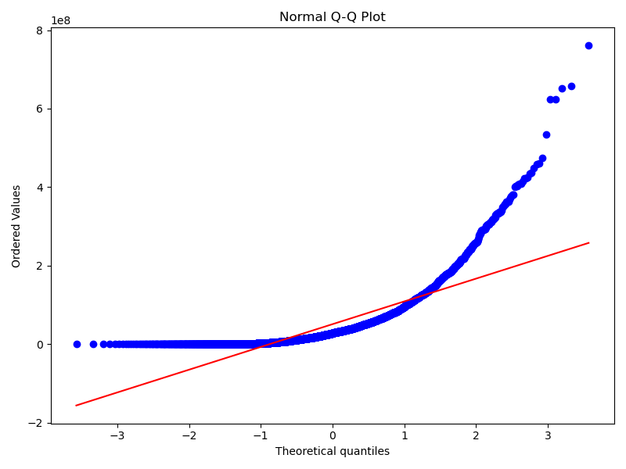
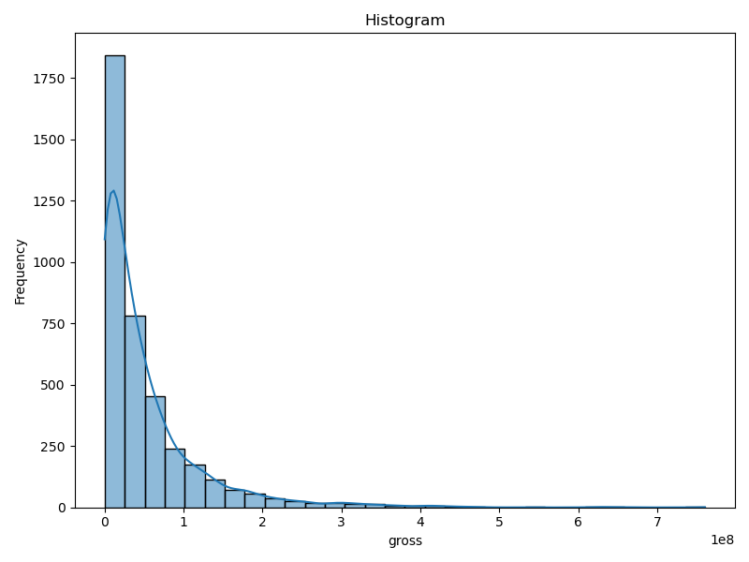

Slide 11
Statistical summary
This statistical summary provides key insights about the 'gross' variable, likely representing movie gross revenue:
Parameter Estimation:
Mean: About $51 million
Standard Deviation: Approximately $70 million
Proportion: 1.0 (suggesting no missing values)
Normality Assessment:
Shapiro-Wilk Test: Statistic ≈ 0.689, p-value = 0.0
D'Agostino's K-squared Test: Statistic ≈ 2618.698, p-value = 0.0

Slide 12
Conclusion: The data does not follow a normal distribution.
The high standard deviation relative to the mean indicates significant variability in gross revenue. The normality tests' extremely low p-values (0.0) strongly reject the null hypothesis of normality, confirming that the gross revenue data is not normally distributed. This suggests a skewed or irregular distribution of movie earnings.

Slide 13
INDEPENDENT VARIABLES
Most of the 12 movie-related variables show right-skewed distributions with significant outliers.
Variables like budget, Facebook likes, and critic reviews exhibit high variability and deviate from normal distribution.
IMDB scores are the exception, approaching a normal distribution with ratings clustered around the middle range.
The release year variable indicates an increasing trend towards recent decades.
These findings suggest the need for non-parametric methods or data transformations in further statistical analysis.

Slide 14
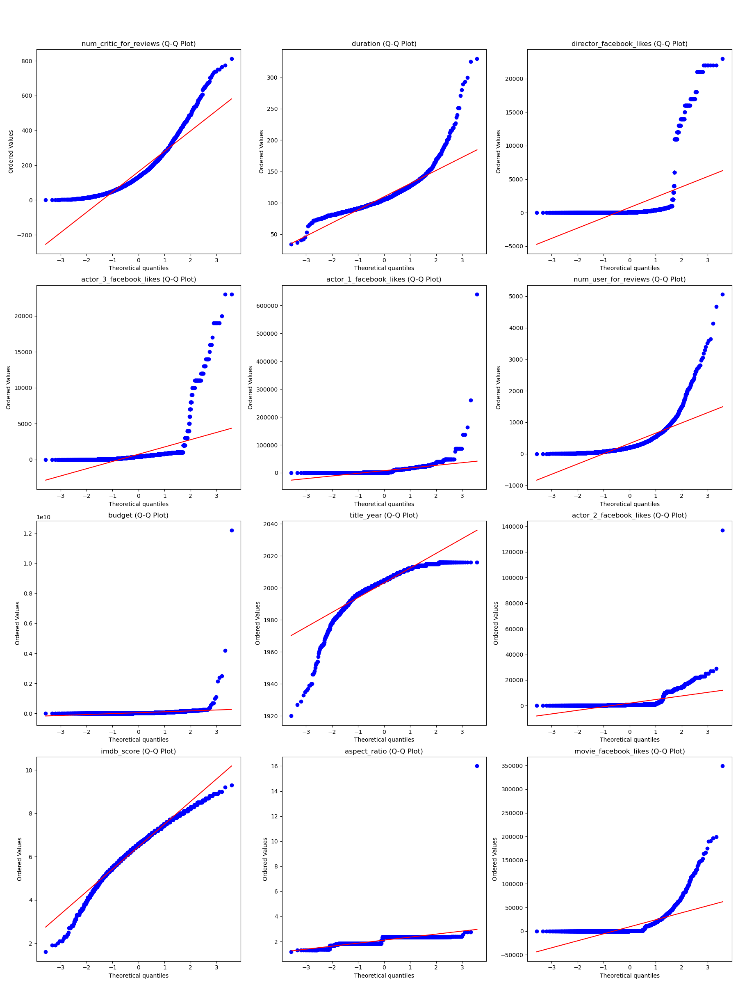
QQ-PLOTS

Slide 15
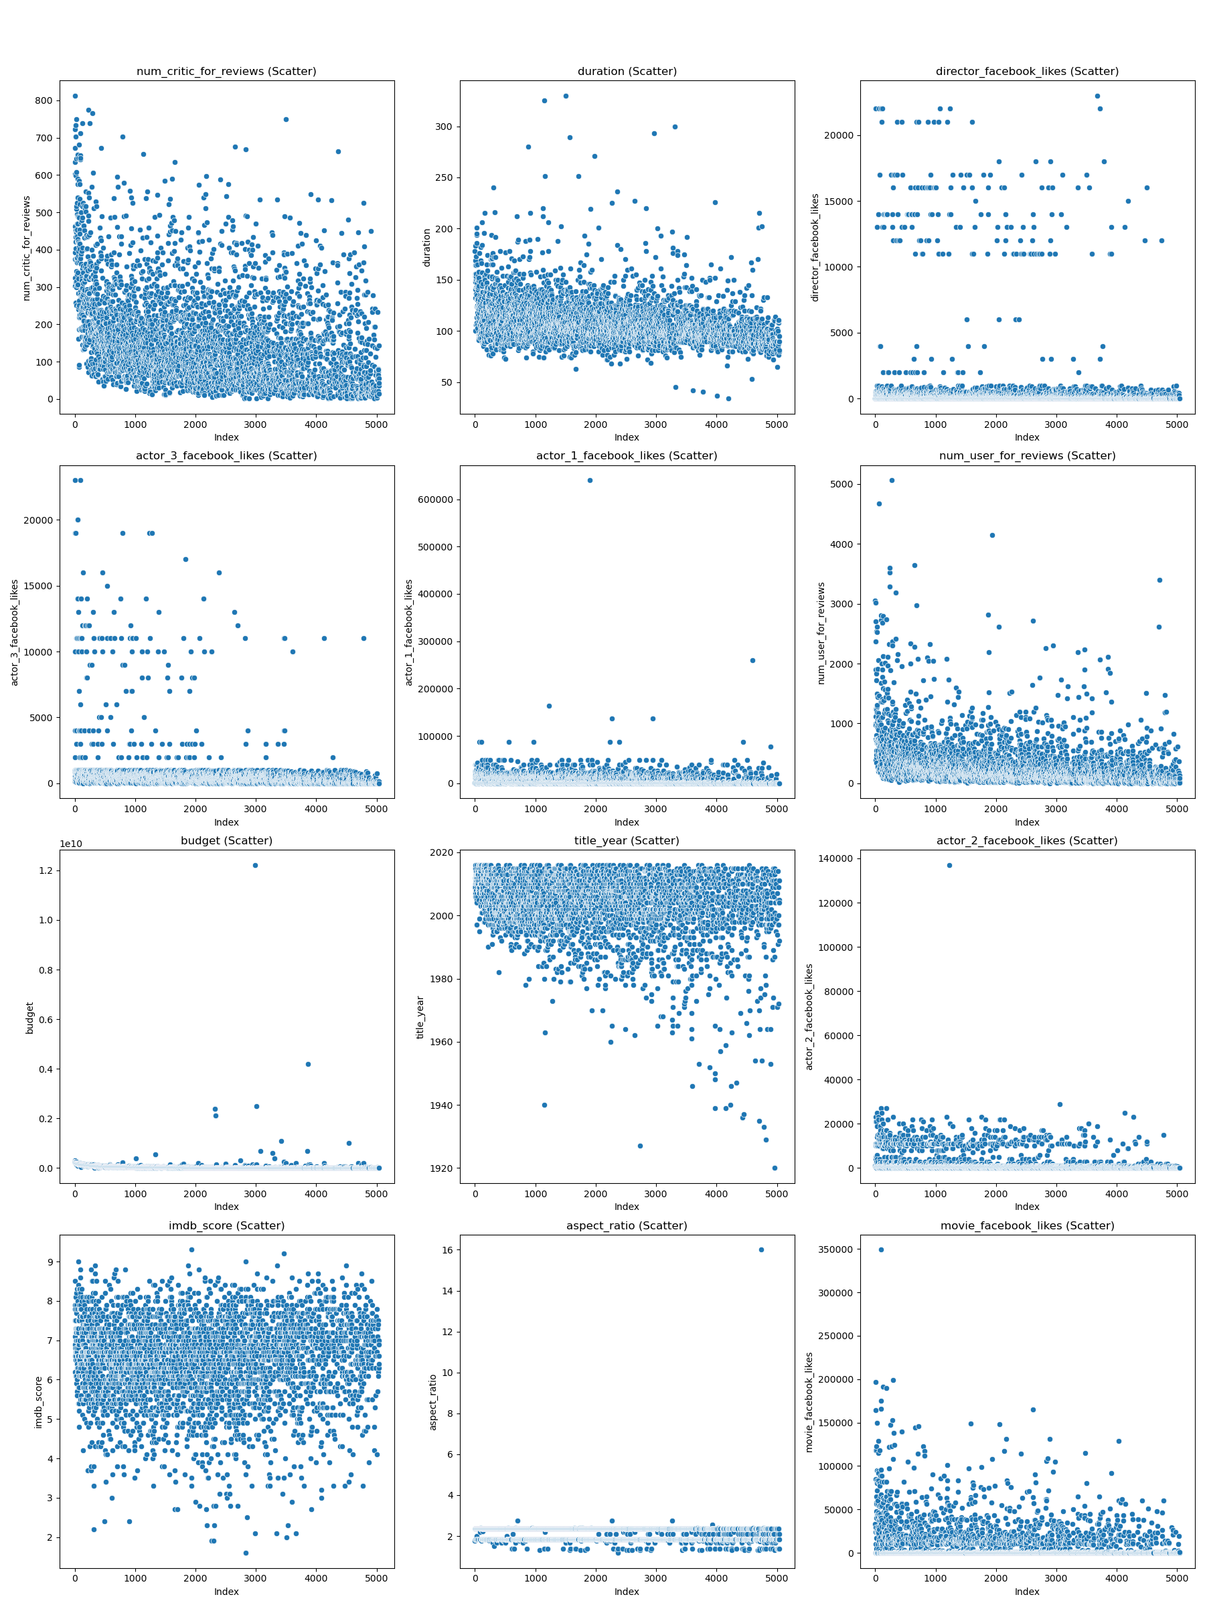
SCATTER PLOT

Slide 16
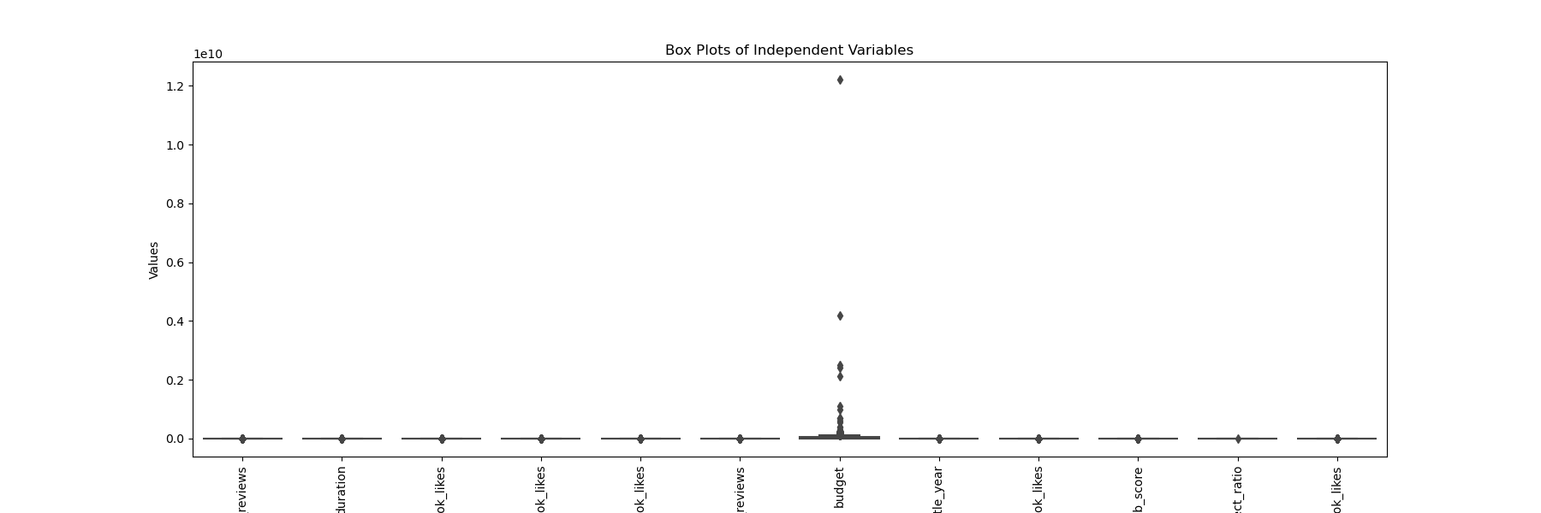
BOX PLOT

Slide 17
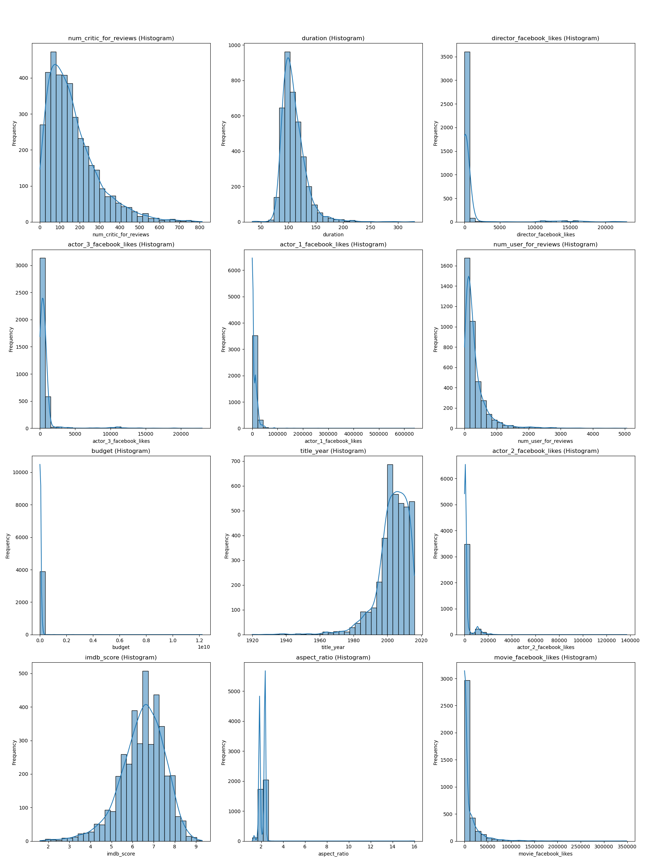
histrograms

Slide 18
Statistical analysis

Slide 19

Correlation Analysis
1. Key Predictors: The correlation matrix identified important factors for box office success, including budget, number of critic reviews, movie duration, combined actor Facebook likes, and IMDb score.
2. Multicollinearity Addressed: Highly correlated variables, such as individual actor Facebook likes, were combined into a single feature (combined_actor_facebook_likes) to reduce multicollinearity.
3. Model Enhancement: The correlation analysis guided the selection of significant variables, improving the accuracy and interpretability of the linear regression model.
4. Visual Insights: A heatmap visualization of the correlation matrix provided clear insights into relationships between variables, supporting a data-driven approach to model development.
5. Regression Findings: The linear regression model quantified the impact of each predictor on gross revenue, with all selected variables showing positive coefficients. The model's performance is indicated by a mean squared error of approximately 399,444,151,463,804.

Slide 20
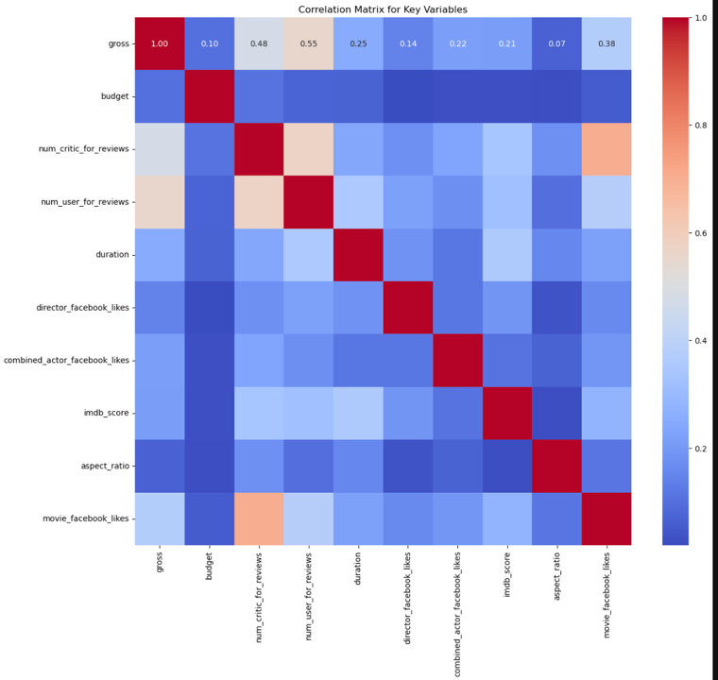
Applied correlation analysis

Slide 21
AFTER MODIFICATION, THE ISSUES USING CORRELATION ANALYSIS
1. Missing Value Treatment: Numerical columns were filled with mean values, while categorical columns were filled with mode values.
2. Feature Combination: Actor Facebook likes were consolidated into a single feature (combined_actor_facebook_likes) to address multicollinearity.
3. Variable Selection: Key predictors were chosen based on their significant correlation with gross revenue, as revealed by the correlation matrix.
4. Model Creation: A linear regression model was developed using selected features: budget, num_critic_for_reviews, duration, combined_actor_facebook_likes, and imdb_score.
5. Evaluation and Interpretation: The model's performance was assessed using Mean Squared Error (MSE), and feature coefficients were analyzed to understand their impact on gross revenue prediction.

Slide 22
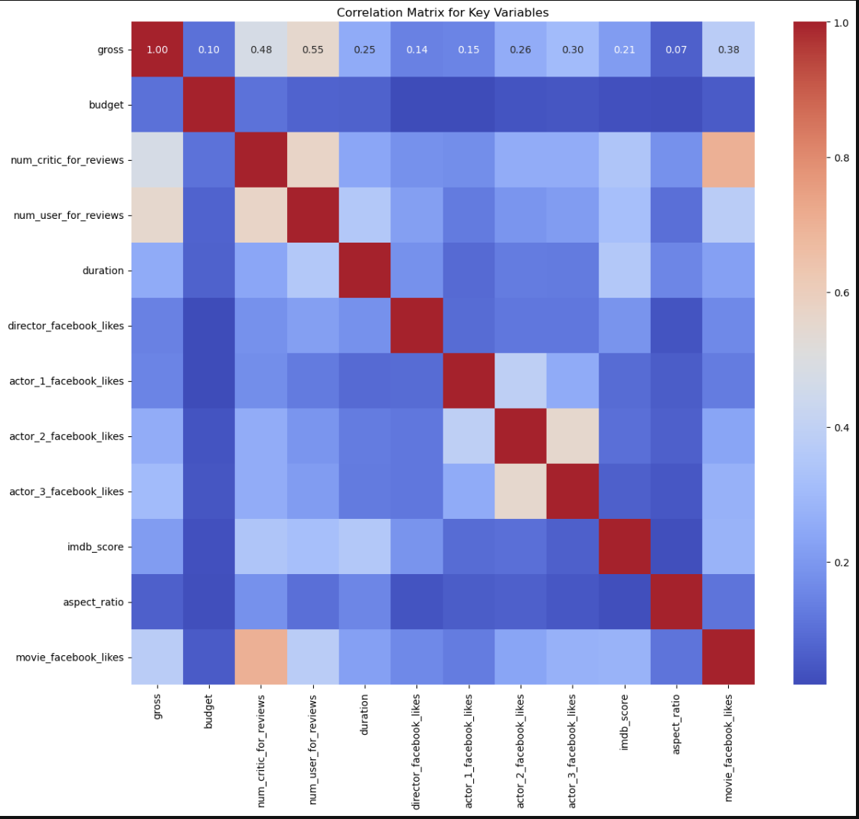
After modification

Slide 23
Hypothesis Testing and Box Plot Analysis
Hypothesis Testing Results:
Correlation between Budget and Gross:
Correlation: 0.10, p-value: 1.68e-10
Interpretation: Weak but statistically significant positive correlation indicating higher budgets are generally associated with higher gross revenue.
ANOVA for Content Rating on Gross:
F-statistic: 36.43, p-value: 4.44e-75
Interpretation: Significant differences in gross revenue across content rating categories, confirming the visual insights from the box plot.
Correlation between Budget and IMDB Score:
Correlation: 0.03, p-value: 6.92e-02
Interpretation: Very weak and not statistically significant correlation indicating that budget does not have a significant impact on IMDB score.

Slide 24
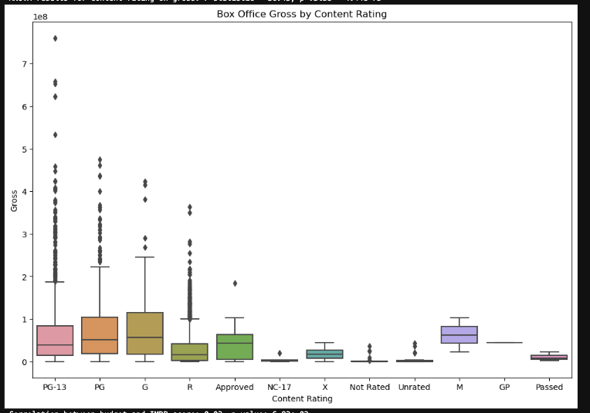

Slide 25
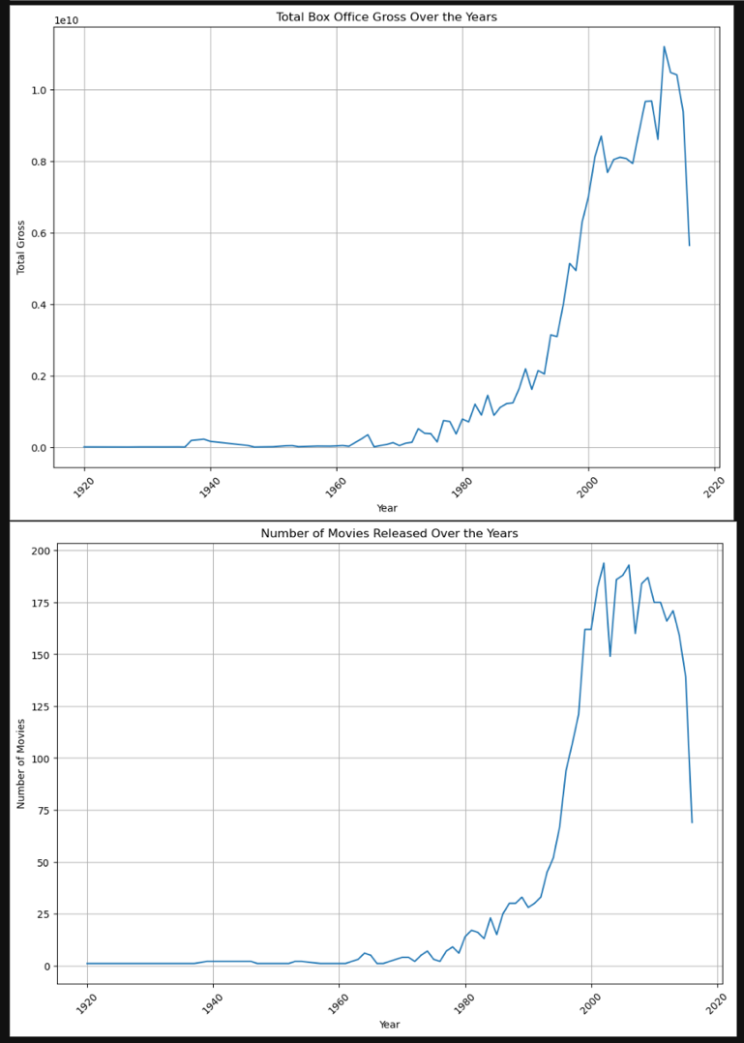
TIME SERIES ANALYSIS
Revenue Trend: Box office gross shows significant growth from 1920 to 2020, peaking in early 2000s. Production Increase:
Number of movies released per year rose substantially, especially from 1980s onward.
Industry Expansion: Both trends reflect overall growth in the film industry and audience demand.
Strategic Value: Data aids in identifying long-term patterns for informed decision-making.
Historical Context: Visualizations provide century-long perspective on film industry evolution.

Slide 26
MODEL DEVELOPMENT AND EVALUATION
Linear Regression:
Performance:
MSE: 399,444,151,464,304.00
RMSE: 632,01615.10
MAE: 41483921.47
R-squared: 0.26
Coefficients:
budget: 0.0002
num_critic_for_reviews: 224737.05
duration: 416543.05
combined_actor_facebook_likes: 378.71
imdb_score: 1,873,176.00
Random Forest:
Performance:
MSE: 258,321,442,478,832.50
RMSE: 508,16476.12
MAE: 32679727.97
R-squared: 0.52
Feature Importance:
budget: 0.433372
num_critic_for_reviews: 0.211933
imdb_score: 0.140132
combined_actor_facebook_likes: 0.107609
duration: 0.106954
Gradient Boosting:
Performance:
MSE: 249,147,531,584,819.00
RMSE: 499,14642.46
MAE: 324,54856.61
R-squared: 0.54

Slide 27
Sampling and Analysis
Random Sampling: Validated budget-related claims
Comparison of Critic vs User Reviews
Correlation Analysis: Reviews vs IMDB Scores
Multi-Regression Models: Improved predictive power

Slide 28
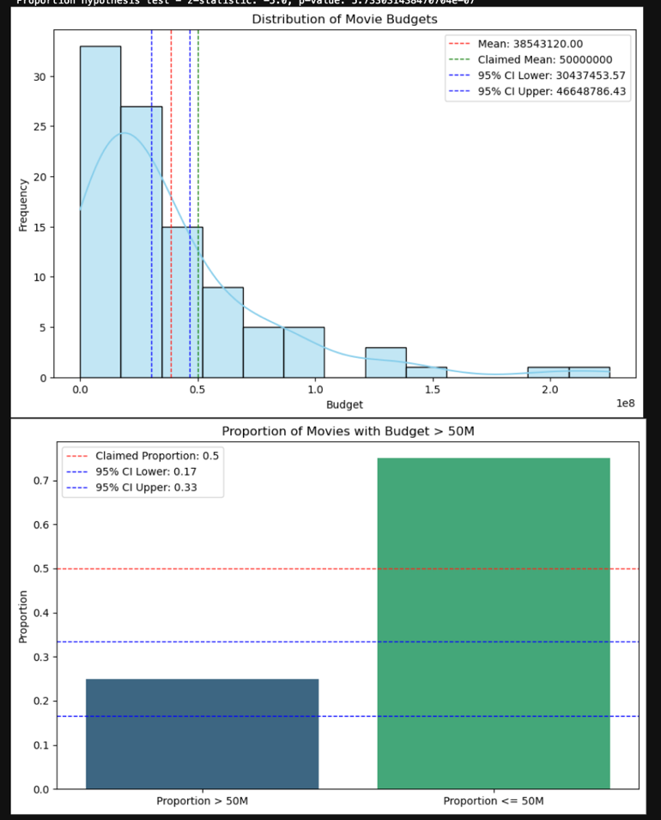
Hypothesis Testing with Random Sampling

Slide 29
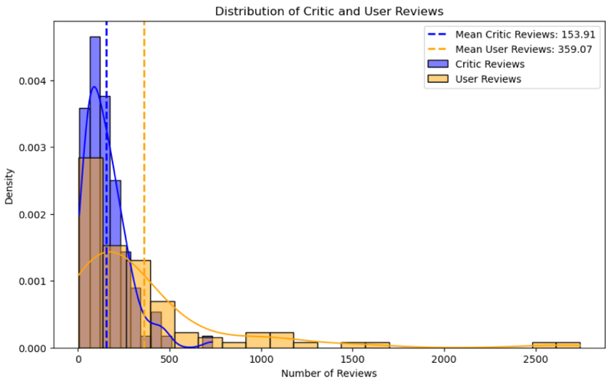
Compare Two Sample Means and SD - Interpretation of Results

Slide 30
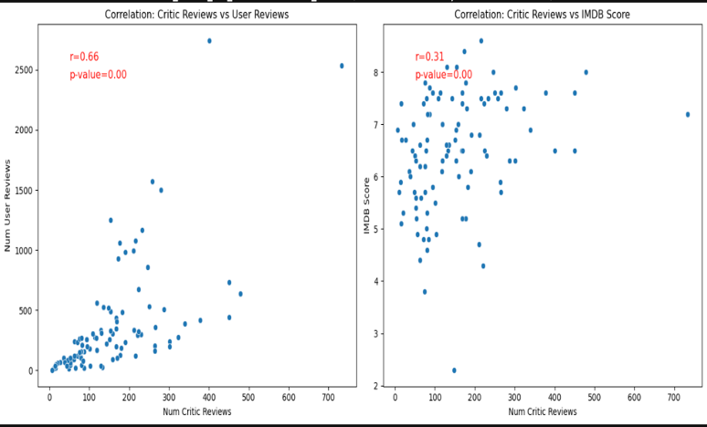
Correlation and Hypothesis Test - Interpretation of Results

Slide 31
PERFORMANCE AND ACCURACY OF THE MODELS
Baseline Model: Multiple Linear Regression
R-squared: 0.26, indicating that the model explains 26% of the variance in box office revenue.
RMSE: 63,201,615.10
MAE: 41,483,921.47
Advanced Models: Random Forests and Gradient Boosting
Random Forests:
R-squared: 0.52, showing improved explanatory power.
RMSE: 50,816,476.12
MAE: 32,679,727.97
Feature Importance:
Budget: 43.34%
Num Critic for Reviews: 21.19%
IMDb Score: 14.01%
Combined Actor Facebook Likes: 10.76%
Duration: 10.70%
Gradient Boosting:
R-squared: 0.54, indicating the best performance among the models.
RMSE: 49,914,642.46
MAE: 32,454,856.61
Feature Importance (similar to Random Forests but slightly different weights)

Slide 32
Responsibilities of Each Group Member
Uday Bhaskar Valapadasu: Data Collection, EDA, ANOVA, Time Series Analysis
Rohit Suddala: EDA, Correlation Analysis, ANOVA, Time Series Analysis
Sapthagiri Naik Bhukya: EDA, ANOVA, Time Series Analysis, Final Report Compilation

Slide 33
Our Achievements from this Project
Developed robust predictive models for box office revenue
Identified key factors influencing movie success
Gained insights into changing dynamics of the film industry
Enhanced skills in data analysis and machine learning

Slide 34
Conclusion
Budget and critic reviews are strongest predictors of box office success Social media metrics (Facebook likes) show significant impact Advanced models (Gradient Boosting) outperform traditional linear regression Findings provide actionable insights for filmmakers and investors

Slide 35
Thank You
Contact Information:
Uday Bhaskar Valapadasu
Rohit Suddala
Sapthagiri Naik Bhukya

